Slide 1



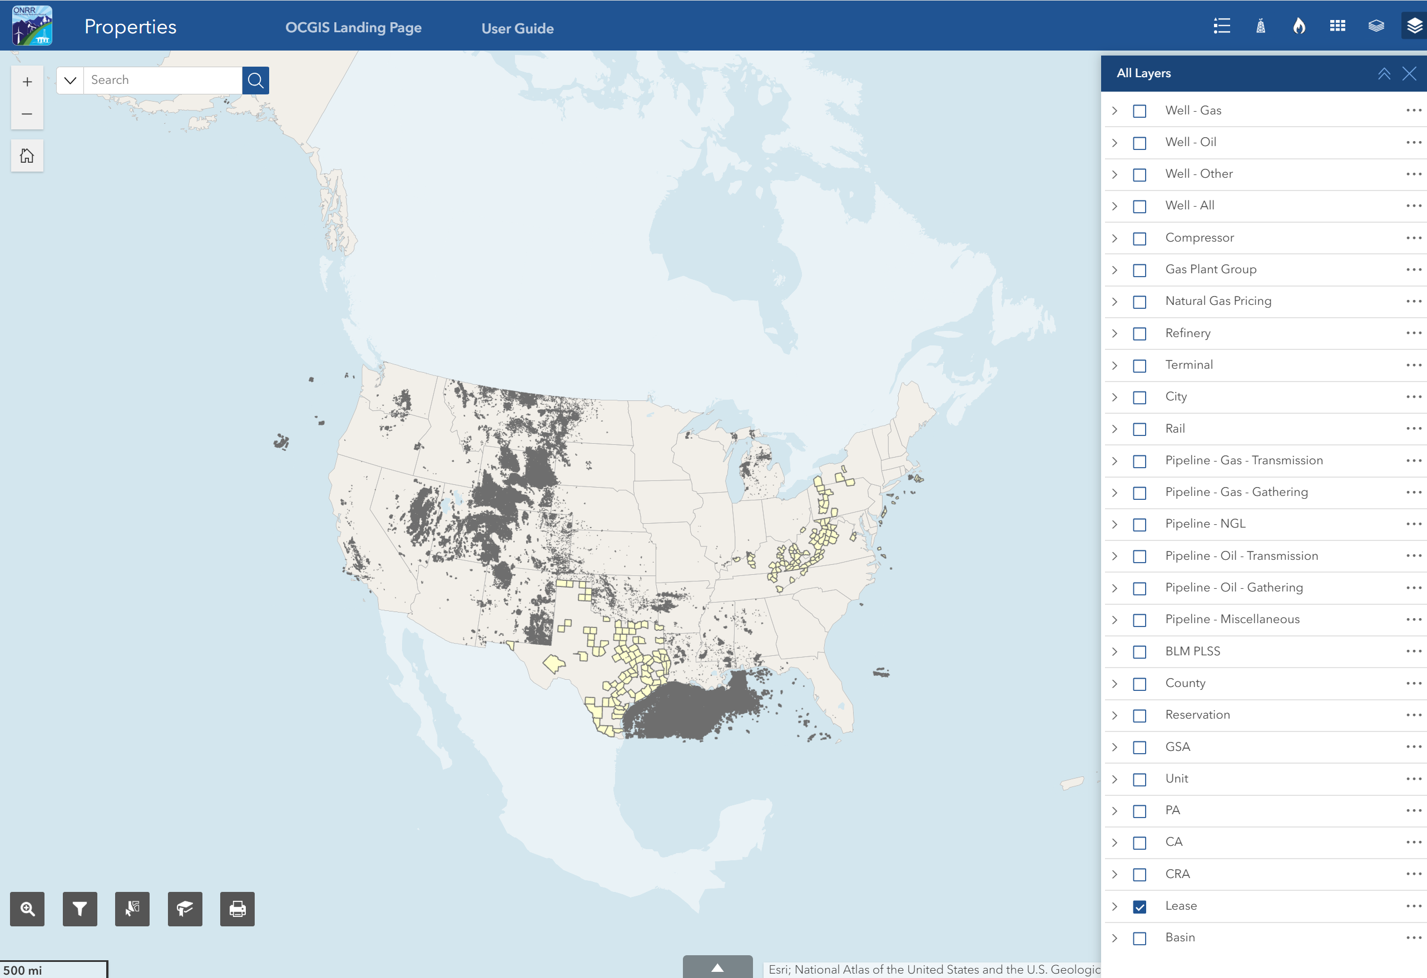





Properties Application Quick Start Guide
The Properties App allows you to explore leases, agreements and associated infrastructure at a national level.
Layer List
Search Widget
Legend
View and toggle map layers using the following layer lists:
All Layers, Base Data, Property, Natural Gas, Crude Oil
Search within specific layers such as leases by contract number or wells by API number
Displays symbology for layers that are turned on
Zoom and Default Extent
Zoom In/Out: Zoom in or out
Default Extent: Return to original map extent
SearchPlus Widget
Search multiple property layers
Filter Widget
Filter layers by criteria such as gas plant by type
Select Widget
Select and highlight features in the map
Bookmark Widget
Create or view saved bookmarks
Print Widget
Print your map into different formats
Attribute Table
View data in an attribute table

